Slide 1



Retail Analytics and Classification
Nirbhay
Paras Khola
Vishal Yadav
Ritika Gupta

Slide 2

Problem
Objective
Manual and barcode-based inventory tracking is slow, error-prone, and lacks real-time insights; there is a need for an automated system that uses AI to detect, count, and monitor retail products directly from video feeds.
Detect and classify retail products in real-time from video feeds using YOLOv8.
Monitor inventory levels and trigger alerts for low-stock items automatically.
Generate analytics on product-wise customer consumption patterns.
Enable visual localization of products on shelves via live camera labeling.
Provide a user-friendly web interface for video uploads and result visualization.

Slide 3
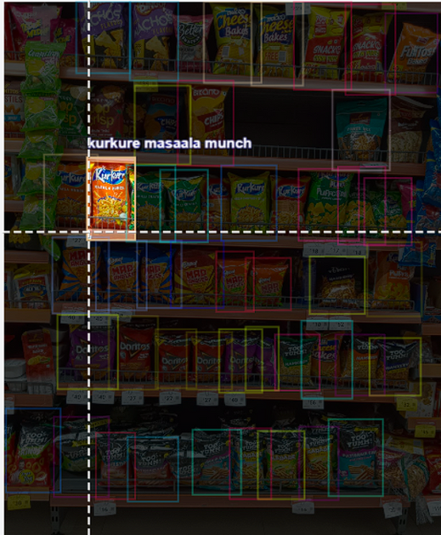
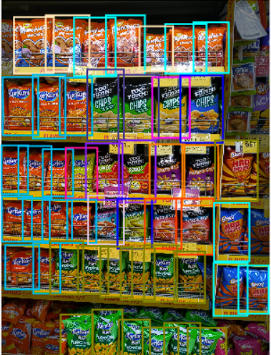
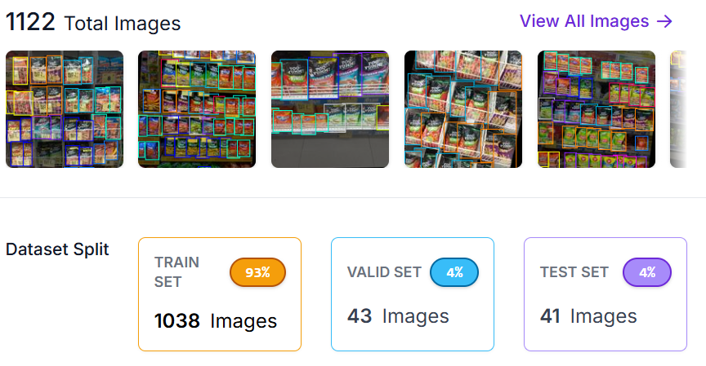
Dataset
We have collect 430 images from different sources.
Using roboflow after data agumentation the data have 1038 train image 43 val_image and 50 testing image
There are 475 classes for detection
1 file of data.yaml after downloading the dataset from roboflow in yolov5pytorch formate which used to train yolov5

Slide 4
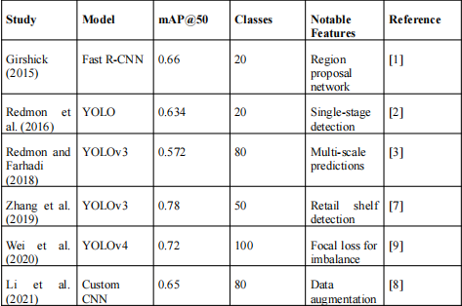

LITERATURE REVIEW

Slide 5
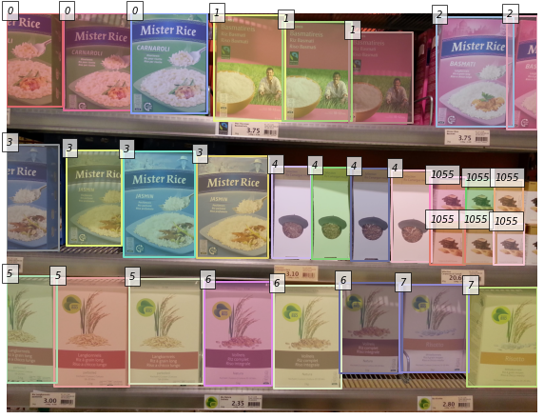
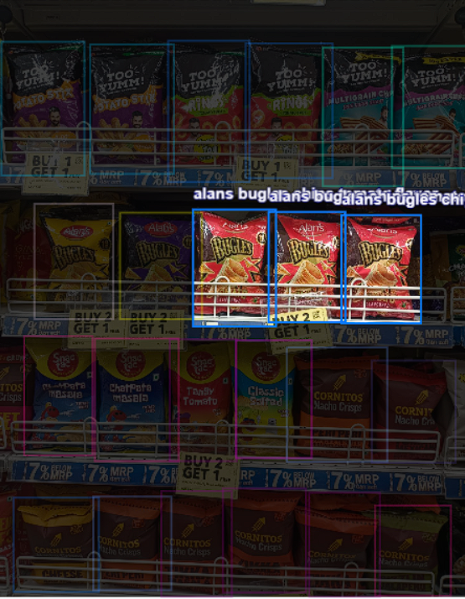
RESEARCH GAP
There is no publicly available dataset containing packed item objects from retail stores with precise product labels.
The existing datasets primarily consist of item images, but the annotations are limited to classification and detection rather than detailed labeling.

Slide 6
Methodology
Tools :
RoboFlow, Google colab and kaggle notebook:
Roboflow used for data anonations
Colab T4 GPU used for model traning and implementations
kaggle notebook also used for better 2XT4GPU
Techniques:
Yolo
Bounding Box Annotation
Data Augmentation
Real-Time Object Detection (OpenCV & TensorFlow ).
Visualization: Matplotlib, Seaborn
Streamlit

Slide 7
Methodology
Data Collection
Boundery Box Annonations
(Using Roboflow)
Creating Dataset
Yolov5 version
Model Training (YOLOv5 and others)
Result Visualisation
Deploying
Model

Slide 8
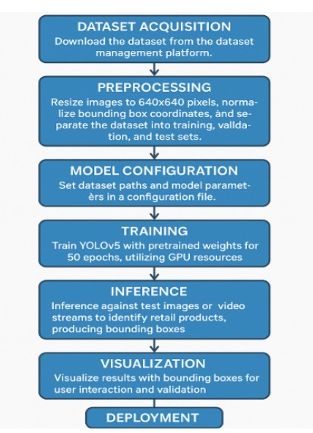
Methodology

Slide 9
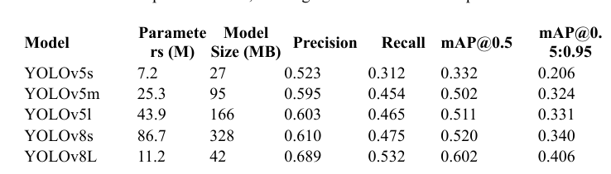
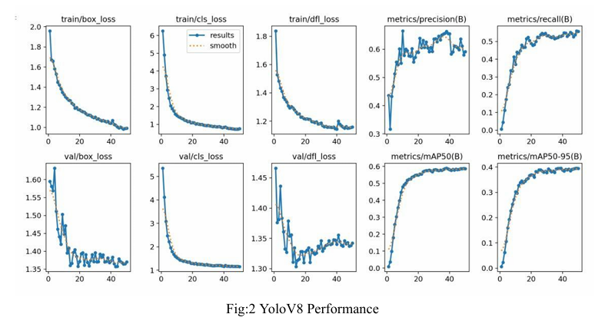
Result

Slide 10
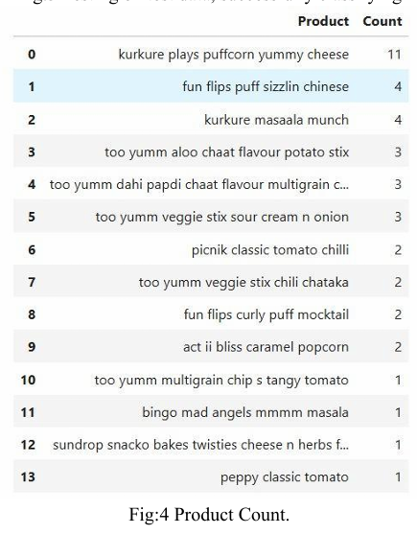
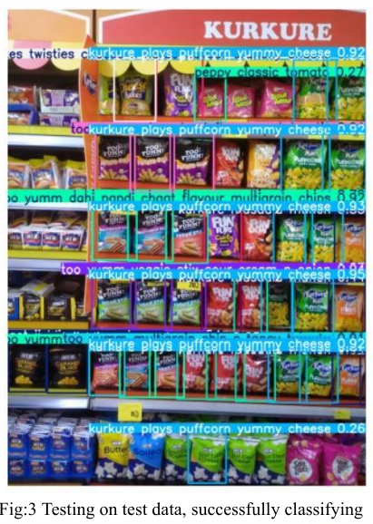
Result

Slide 11
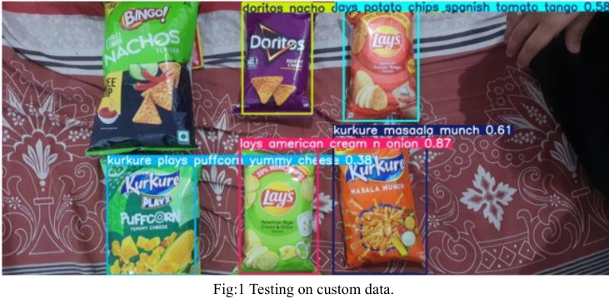
Result

Slide 12
DEMO>>>

Slide 13
Challenges
There is huge object in retial market to classify but lack of data which effect the model accuracy
Computational power : as we go for further training and fine tuning we need to excess a GPU
Testing: In local shops they have local products which are not cover inside the training

Slide 14
Thank You

